Slide 1

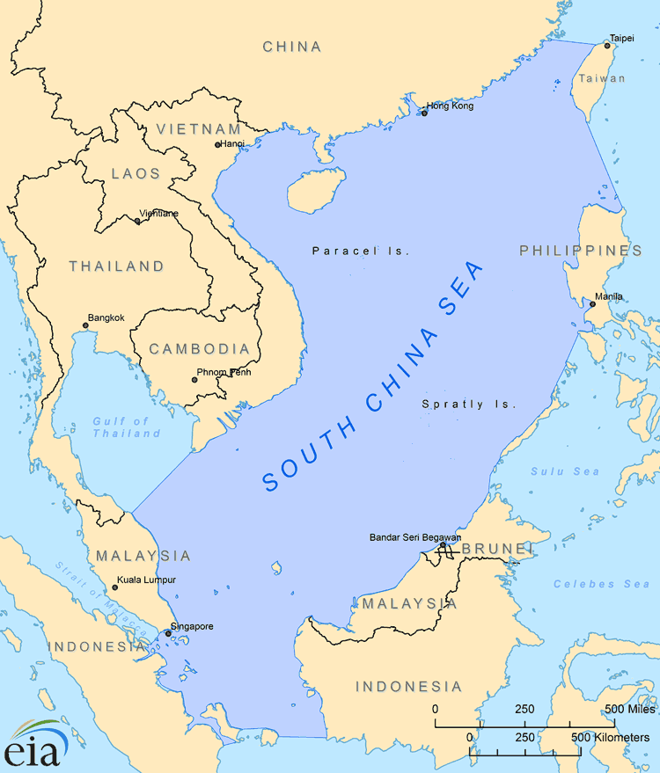
Discourse in the South China Sea
Aurora Holland, Silan Gitterman, Ryan Skelly
CS457 - 4/14/23

Slide 2
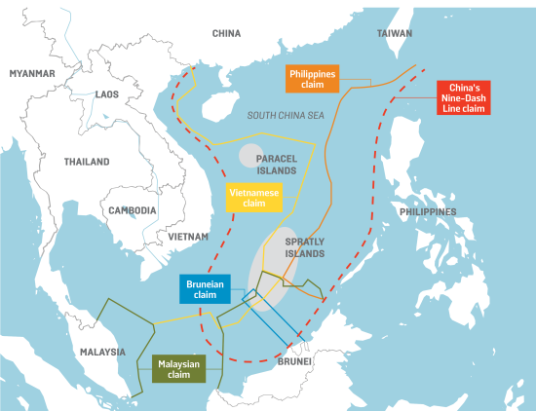
Introduction
China, the Philippines, Vietnam, Thailand, Taiwan, Malaysia, and Indonesia
Shipping lanes
1/3rd of Global Goods
Militarization Efforts
Territorial Disputes
Notes:
Off the coast of China, the Philippines, Vietnam, Thailand, Taiwan, Malaysia, and Indonesia, lies a few of the world’s most crucial and trafficked shipping lanes. These water highways are where the majority of the world's largest exporter’s goods are shipped, and if there were any problems at sea, the world economy would be hit the hardest. For a long time, the ownership of the South China Sea has been heavily disputed. China has been slowly building military islands for the strategic monitoring of trade and ensuring everything’s running smoothly, although some of its neighbors claim that they’re being constructed outside of China’s own country boundaries. Tensions are slowly rising in the region, and it’s only a matter of time before things escalate.

Slide 3
Happiness
How has the overall happiness of China and the neighboring countries been affected over time by the disputes?
World Happiness Report data
Comparing change in Happiness Score from 2015-2022
China, Vietnam, Thailand, Taiwan, Malaysia, Indonesia

Slide 4
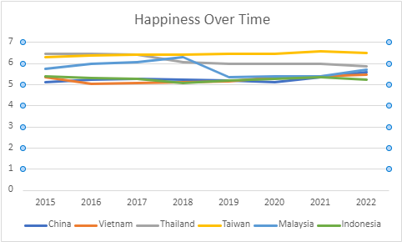
Relatively stable happiness scores
Malaysia shares a large coastline with the South China Sea
China’s score increases the most overall
No major effect on happiness score

Slide 5
Economy
How have the disputes affected the economy of China and the neighboring countries?
World Happiness Report data
Comparing change in GDP over time from 2015-2022
Excluding 2020 and 2021 because it was collected as logged GDP rather than just GDP

Slide 6
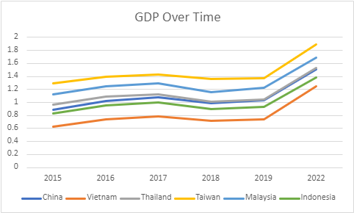
All the lines from 2015-2019 move in roughly the same way
Significantly higher GDP for all countries in 2022
Most recent disputes could potentially show a more dramatic effect in later years

Slide 7
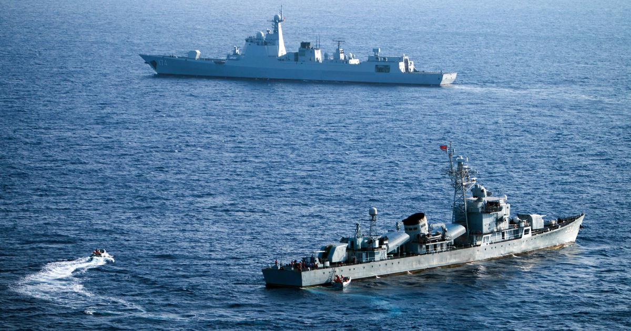
Conflicts
Has the conflicts that occur each year increased?
Armed Conflict Location & Event Data Project (ACLED)
Ranging from 2020-2023, due to access restrictions
Insight into how frequent issues are
Notes:
Has the conflicts that occur each year increased?(Ryan)
The number of conflicts can generally be used to show how each country has been responding to China’s advancements and if it's becoming a more common occurrence. From initial research into the disputes, it's been stated that Japan, the US, and the UN have also been policing the Sea, which serves as more potential to gain insight into the dynamics of the region. An increase in conflicts could indicate China’s starting a more aggressive approach. A decrease could show that tensions are de-escalating, and that the surrounding countries are starting to regain control.

Slide 8
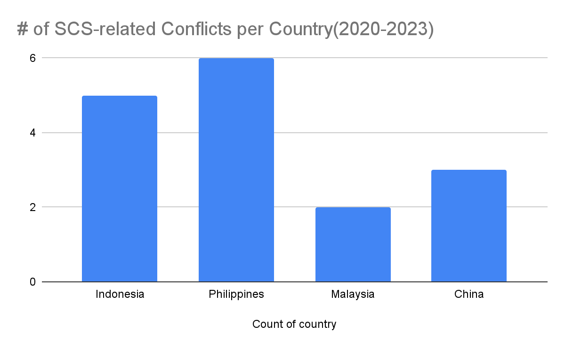
Conflicts
Limitations
Spratly Islands
Text
Notes:
This chart shows the number of SCS-related conflicts in the target countries. As displayed by the graph, the majority of conflicts over the past three years have been in the Philippines. While each conflict is unique, one can take away that these conflicts are a result of the Philippines being the closest in a geographic location to the Spratly Islands. This is where the majority of intercountry-specific conflicts are occurring. The Spratly Islands are the most disputed region of the South China Sea, so it makes sense to have the largest number of disputes.

Slide 9
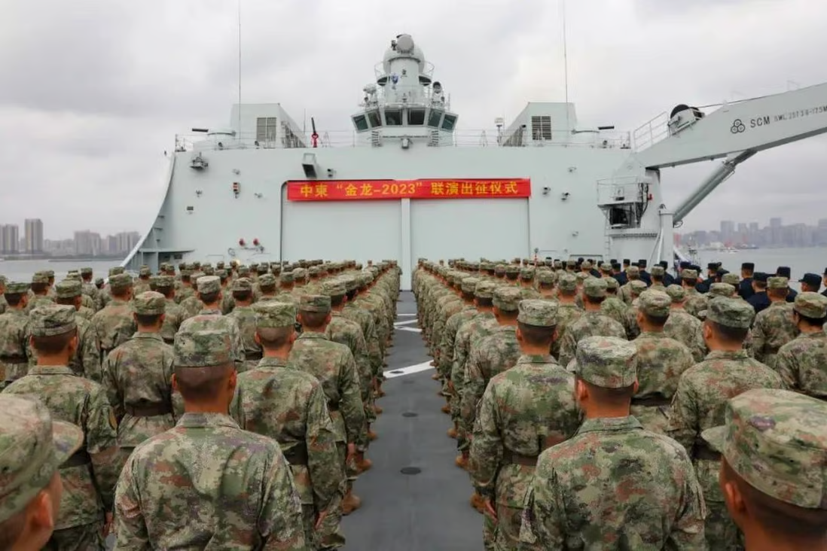
Military Expenditure
Has the military expenditure of countries surrounding the region increased?
SIPRI Military Expenditure Database
Ranging from 2000-2022
Gauging resistance efforts of neighboring countries
Notes:
Has the military expenditure of countries surrounding the region increased?(Ryan)
Military Expenditure per Country surrounding the SCS can be used to show how likely it is that a country suspects conflict arising in the near future. Militaries can also be used in civil conflicts, thus data could be skewed for different reasons, not pertaining to South China Sea disputes. An increase in any country could provide evidence of disputes if prior behaviors differed for the country in question. In addition to military expenditure, size of military, and also type of military(Like Naval) could also show preparation efforts

Slide 10
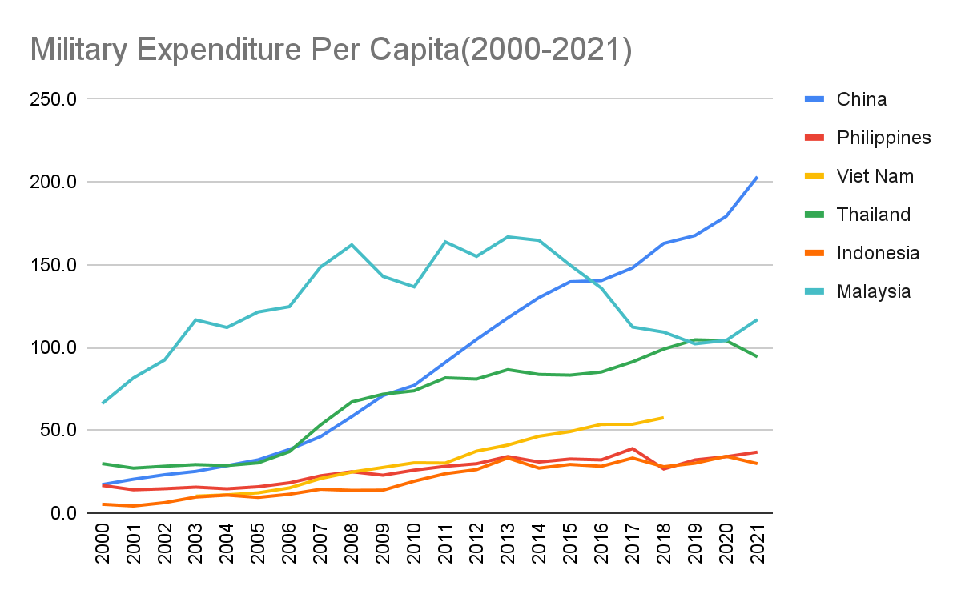
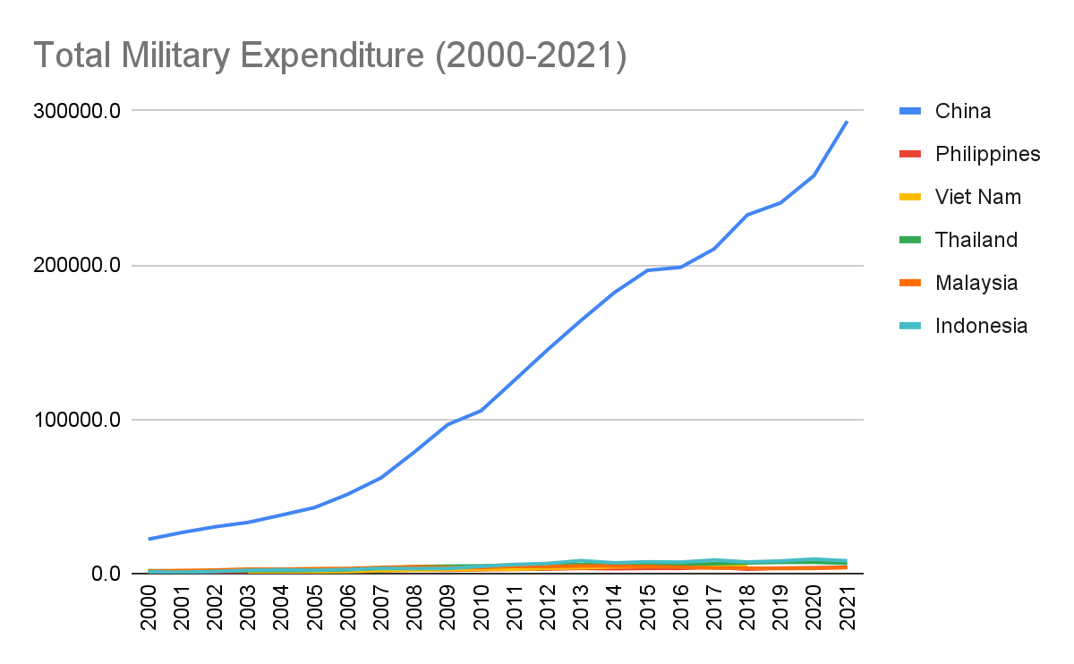
Military Expenditure
Not Surprising
Per Capita/Total
US, Japan, and UN
Notes:
These two charts show Military Expenditure, in totality as well as per capita. Due to the size and population of China, China ranks the highest as of 2021, which has likely continued to the present day. This isn’t surprising although, between the two charts, it's clear to see that per capita is a better visualization, as it's easier to distinguish rankings. Due to the localization of the Philippines, It is concerning that they have the second lowest Expenditure per capita, while being the closest to the Spratly Islands. As China has a total expenditure that dwarfs all other surrounding countries in comparison, its clear if conflict were ever to arise, it’d be hard for single countries to stand in opposition to their demands/advances.

Slide 11
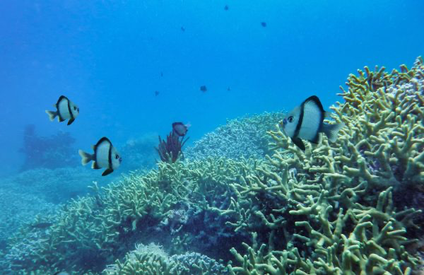
Ecosystems
What would happen to the marine ecosystems if China fully controlled the South China Sea?
Many Coral Reefs and Marine organisms
Increasing the shipping over the Sea would cause a lot of harm
South China Sea is particularly vulnerable to climate change
Notes:
The South China Sea is a globally important marine ecosystem. It contains a lot of coral
reeds, seagrass beds, and mangrove forests, which provide important habitats for fish, turtles,
and other marine organisms. Increasing the shipping, oil, and gas drilling could have negative
environmental consequences for marine ecosystems. The South China Sea is particularly
vulnerable to climate change and ocean acidification. Ocean acidification is a process where
CO2 in the atmosphere dissolves into seawater which releases a decrease in pH and an increase
in acidity. This can have very negative effects on marine organisms. This includes the reduced
ability to form and maintain shells, decreased growth and reproduction rates, and more.

Slide 12
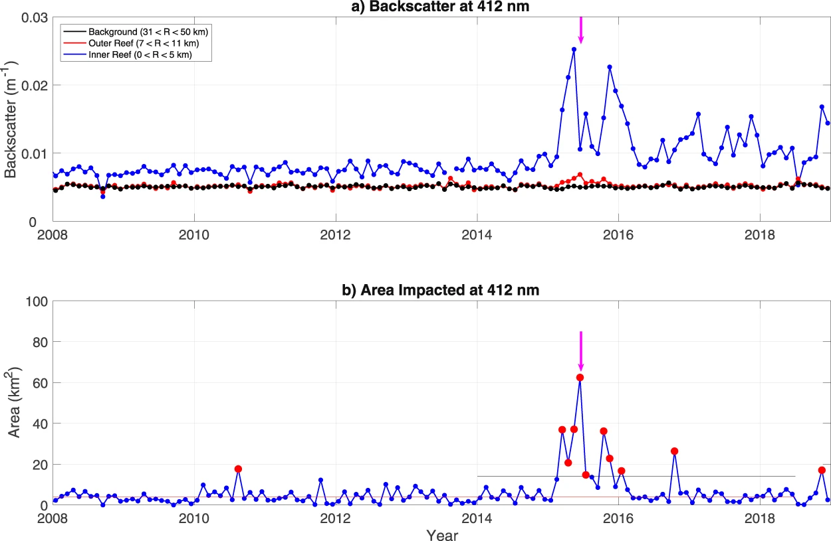
Ecosystem
Stable environment in early years
Dramatic change around 2015
Small changes in outer reef area due to it being in the open ocean

Slide 13
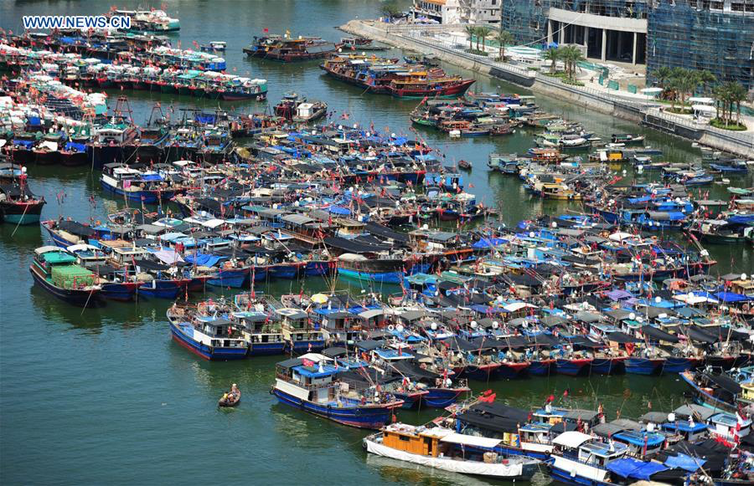
Conservation and sustainability
What effects does the dispute have on the conservation and sustainability in the region?
increased competition for fishery resources results in unsustainable fishing practices
Warmer sea temperatures drive fish away which jeopardizes the jobs of fisherman
Notes:
The South China Sea dispute has major effects on the conservation and sustainability of the region. As I’ve mentioned before, if China gained control over the Sea, it would cause habitat destruction for marine organisms. Overfishing would also be a result of the dispute in the South China Sea. It has led to increased competition for fishery resources which could also result in unsustainable fishing practices. Increased shipping oil and gas drilling (as mentioned above) could lead to pollution, which would harm not only marine organisms but also threatens human health and impacts water quality. Climate change would also be a result of the South China Sea feud. Due to the fact that the South China Sea is vulnerable to climate change, the sea temperatures are rising, which results in ocean acidification and the destruction of coral reefs. This impacts not only the biodiversity in the area but also the food chain.

Slide 14
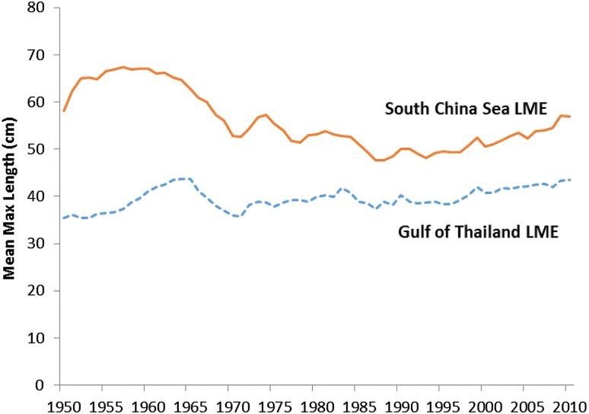
Conservation and Sustainability
ML has declined substantially in the mid 1960s
Lowest level was reached in the mid 1970s
Mean and max length of catches in the GOT and SCS.
Notes:
This graph shows that the ML declined substantially in the mid-1960s as the region’s fisheries became increasingly overexploited following rapid expansion of the industrial fishing sector. The lowest level was reached in the mid-1970s for the Gulf of Thailand LME, and mid-1980s for the SCS LME, after which the mean maximum length remained fairly stable, with slight increases since 2000 in both LMEs. The loss of large predatory species can affect ecosystem structure, function, and resilience, with resulting socio-economic and management consequences. Cascading effects, wherein the decrease in predator abundance leads to an explosion in their prey population, can shift the socio-economic dynamics of the fishery, and also increase variability and instability in the system, thereby posing substantial challenges for fisheries management (What is at stake).

Slide 15
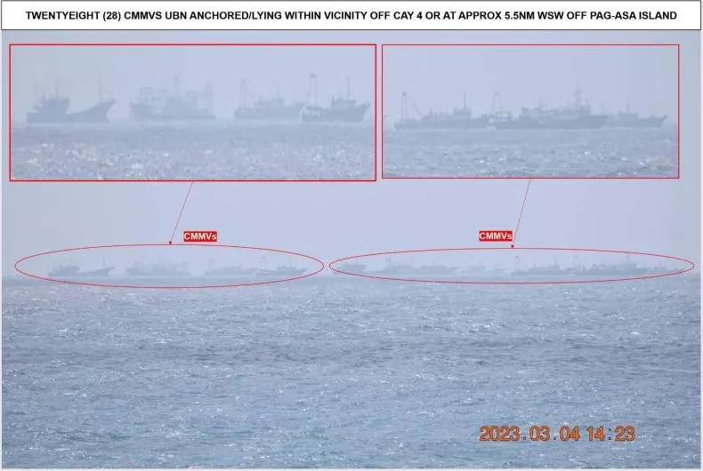
Discussions
“Will the South China Sea Spark the Next Global Conflict?”
“China's Maritime Militia Swarms Philippine-Held Island in South China Sea.”

Slide 16
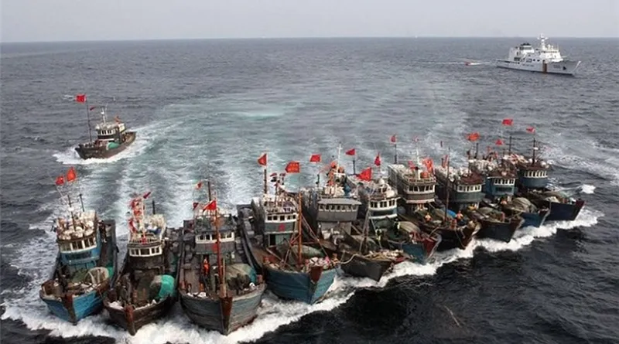
Conclusions
Little to no
News is much more noticeable
Limited Occurrence

Slide 17
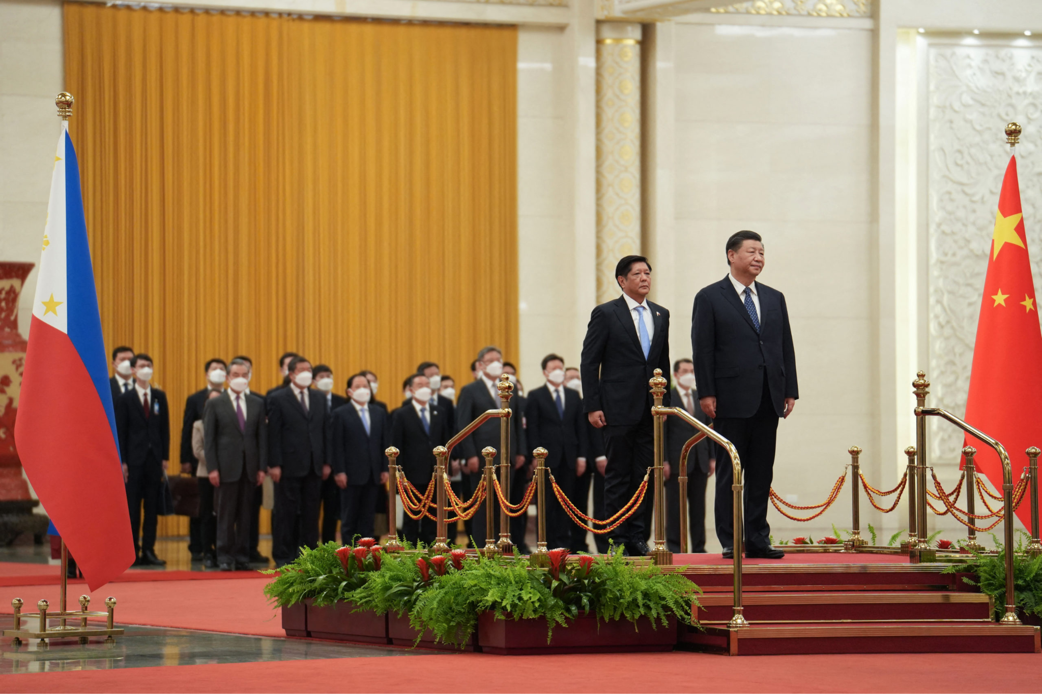
Action Plan
ASEAN, and UNCLOS
Diplomacy
Notes:
Identify who to work with to improve the situation:
To help improve the situation in the South China Sea, collaboration is needed among various stakeholders. This includes governments, international organizations, non-governmental organizations, and other actors with an interest in the region.
The Association of Southeast Asian Nations (ASEAN) could be a potential partner to work with, given their mandate to promote regional peace, stability, and economic integration.
The United Nations Convention on the Law of the Sea (UNCLOS) could also play a critical role in resolving the disputes through its provisions on maritime jurisdiction and dispute settlement mechanisms.
Civil society groups and non-governmental organizations that work on human rights, peace, and environmental issues could also be important allies in advocating for a peaceful and just resolution to the disputes.
Identify who to present the findings to:
The findings of this report could be presented to policymakers, diplomats, and other relevant actors at the national and international level.
This could include presenting the report to the governments of the countries involved in the territorial disputes, as well as to regional organizations such as ASEAN and international organizations such as the United Nations.
The findings could also be disseminated through various media outlets and platforms, such as social media, to reach a wider audience and increase awareness of the situation.
Call to action:
The report highlights the urgent need for a peaceful and just resolution to the territorial disputes in the South China Sea.
The call to action is for all stakeholders to work together to find a diplomatic solution to the disputes, and to respect the rights of all those who depend on the sea for their livelihoods and well-being.
This includes upholding the rule of law, respecting the sovereignty of all states, protecting human rights, and promoting environmental sustainability in the region.
Ultimately, the call to action is for all stakeholders to prioritize peace, dialogue, and cooperation, and to avoid any actions that could escalate tensions or lead to conflict in the South China Sea.

Slide 18
Sources
Heydarian, R. J. (n.d.). Will the south china sea spark the next global conflict? Diplomat Magazine.
https://www.viet-studies.net/kinhte/SCSGlobalConflict_Diplo.pdf
Chang, G. (2023, March 8). China's Maritime Militia Swarms Philippine-Held Island in South China Sea. Newsweek.
https://www.newsweek.com/chinas-maritime-militia-swarms-philippine-held-island-south-china-sea-1681424
Sustainable Development Solutions Network. (n.d.). World happiness report. Kaggle.
https://www.kaggle.com/datasets/unsdsn/world-happiness?select=2015.csv
Sustainable Development Solutions Network. (n.d.). World happiness report. Kaggle.
https://www.kaggle.com/datasets/unsdsn/world-happiness?select=2016.csv
Sustainable Development Solutions Network. (n.d.). World happiness report. Kaggle.
https://www.kaggle.com/datasets/unsdsn/world-happiness?select=2017.csv
Sustainable Development Solutions Network. (n.d.). World happiness report. Kaggle.
https://www.kaggle.com/datasets/unsdsn/world-happiness?select=2018.csv
Sustainable Development Network Solutions. (n.d.). World happiness report. Kaggle.
https://www.kaggle.com/datasets/unsdsn/world-happiness?select=2019.csv
Londeen, M. (n.d.). World happiness report 2020. Kaggle.
https://www.kaggle.com/datasets/londeen/world-happiness-report-2020
Singh, A. (n.d.). World happiness report 2021. Kaggle.
https://www.kaggle.com/datasets/ajaypalsinghlo/world-happiness-report-2021:
Singh, A. (n.d.). World happiness report 2022. Kaggle.
https://www.kaggle.com/datasets/ajaypalsinghlo/world-happiness-report-2022
Armed Conflict Location & Event Data Project. (n.d.). ACLED Data Export Tool.
Retrieved March 11, 2023, from https://acleddata.com/data-export-tool/
Stockholm International Peace Research Institute. (n.d.). SIPRI Military Expenditure Database.
Retrieved March 11, 2023, from https://milex.sipri.org/sipri
Smith, L., Cornillon, P., Rudnickas, D., & Mouw, C. B. (2019, March 28). Evidence of environmental changes caused by Chinese island-building. Nature News.
Retrieved April 1, 2023, from https://www.nature.com/articles/s41598-019-41659-3#citeas

